Slide 1
Virtualization vs Cloud
Introduction
Both cloud computing and virtualization are key technologies in modern IT infrastructure, but they serve different purposes.
What is Virtualization?
Virtualization is the process of creating multiple virtual environments from a single physical hardware system. It enables the running of multiple operating systems (OS) on the same physical server using a hypervisor.
Example: Running Windows and Linux on the same physical machine using VMware or Hyper-V.

Slide 2
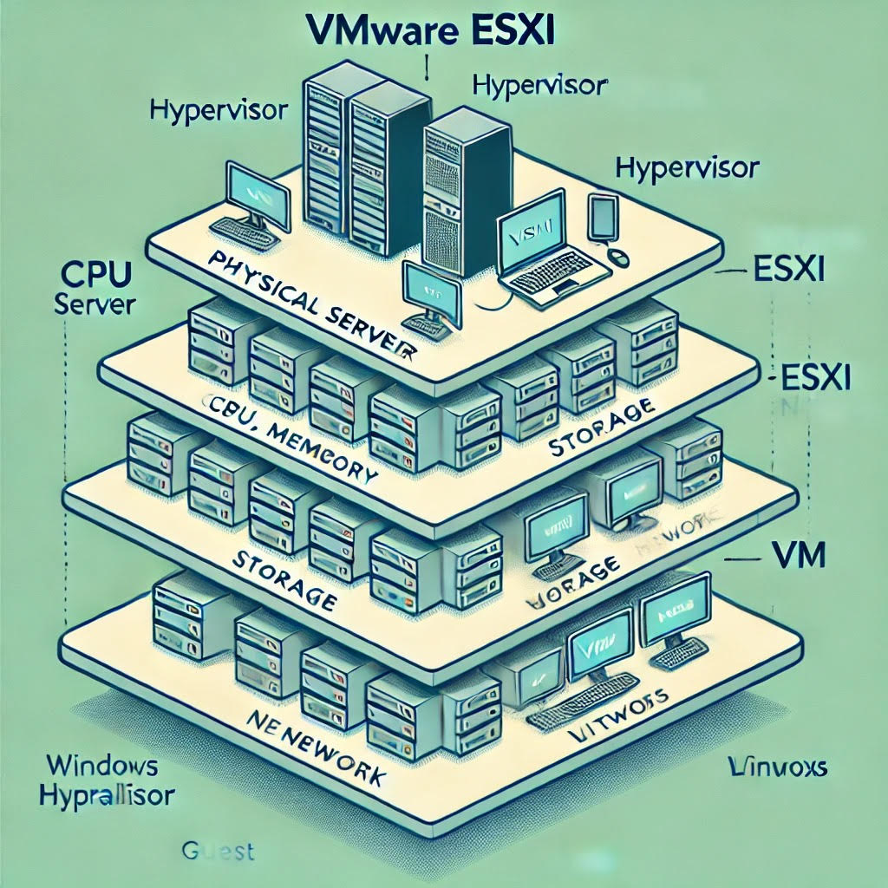
VMware Architecture

Slide 3
Conclusion
Virtualization enables multiple OS instances on a single machine, reducing hardware costs.
Cloud computing provides on-demand, scalable computing resources without hardware management.
Cloud computing relies on virtualization to deliver services efficiently.

Slide 4
What is Cloud Computing?
Cloud computing refers to the delivery of computing services—such as servers, storage, databases, networking, software, and more—over the internet (the "cloud"). It provides on-demand access, scalability, and flexibility.
Example: Using Microsoft Azure, AWS, or Google Cloud to host applications and services without managing physical servers.

Slide 5
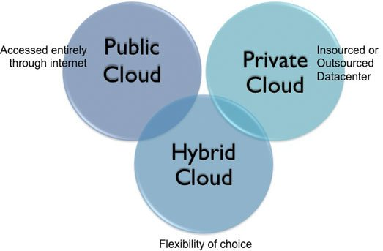
Cloud Computing Model

Slide 6
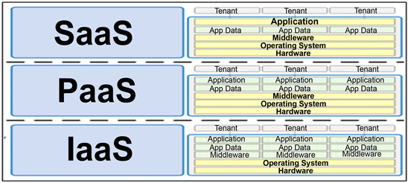
Cloud Services

Slide 7


Key Differences(Virtualization & Cloud)
Feature | Virtualization | Cloud Computing
Definition | Technology that enables multiple OS on a single physical machine | On-demand computing resources delivered over the internet
Infrastructure | Requires physical servers with hypervisors | Fully managed by cloud providers
Resource Allocation | Static, pre-defined | Dynamic and scalable
Scalability | Limited by physical hardware | Highly scalable
Cost Model | Requires upfront investment in hardware | Pay-as-you-go model
Management | Managed by IT teams on-premises | Managed by cloud providers
Deployment Speed | Slow (manual setup required) | Fast (automated provisioning

